Slide 1
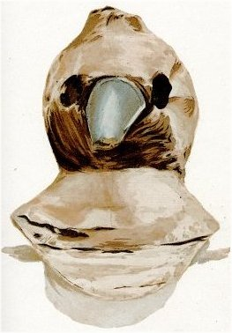
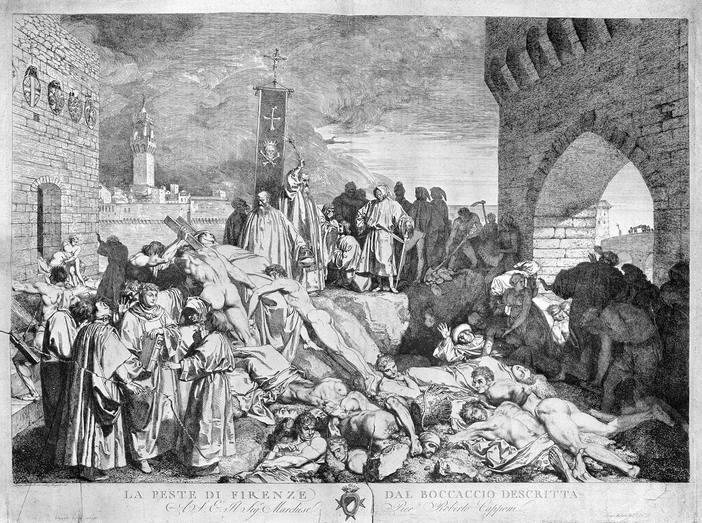
THE MEDIEVAL WORLD
THE BLACK
DEATH
STATION ONE
TREATING THE BLACK DEATH
Using the materials provided, you are required to create a replica plague doctor mask. You should include the same basic structure as a traditional plague doctor mask and ensure that your nose and mouth are adequately covered.
AVAILABLE MATERIALS:
Information card
Black card
Toilet rolls
Sticky tape
Glue
Elastic
THE MEDIEVAL WORLD
THE BLACK
DEATH
STATION TWO
THE SPREAD OF THE BLACK DEATH
The Black death spread through Europe and the Mediterranean world causing huge loss of life everywhere it went. Using the information card and interactive map as a guide, illustrate the path of the black death across the Mediterranean and Europe on the blank world map.
AVAILABLE MATERIALS:
Information card
Interactive map: https://www.scribblemaps.com/maps/view/Spread_of_the_Black_Plague/0206
Blank map

Slide 2
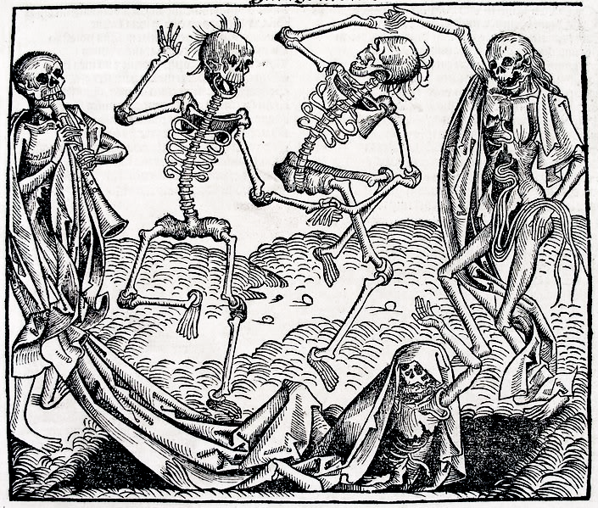
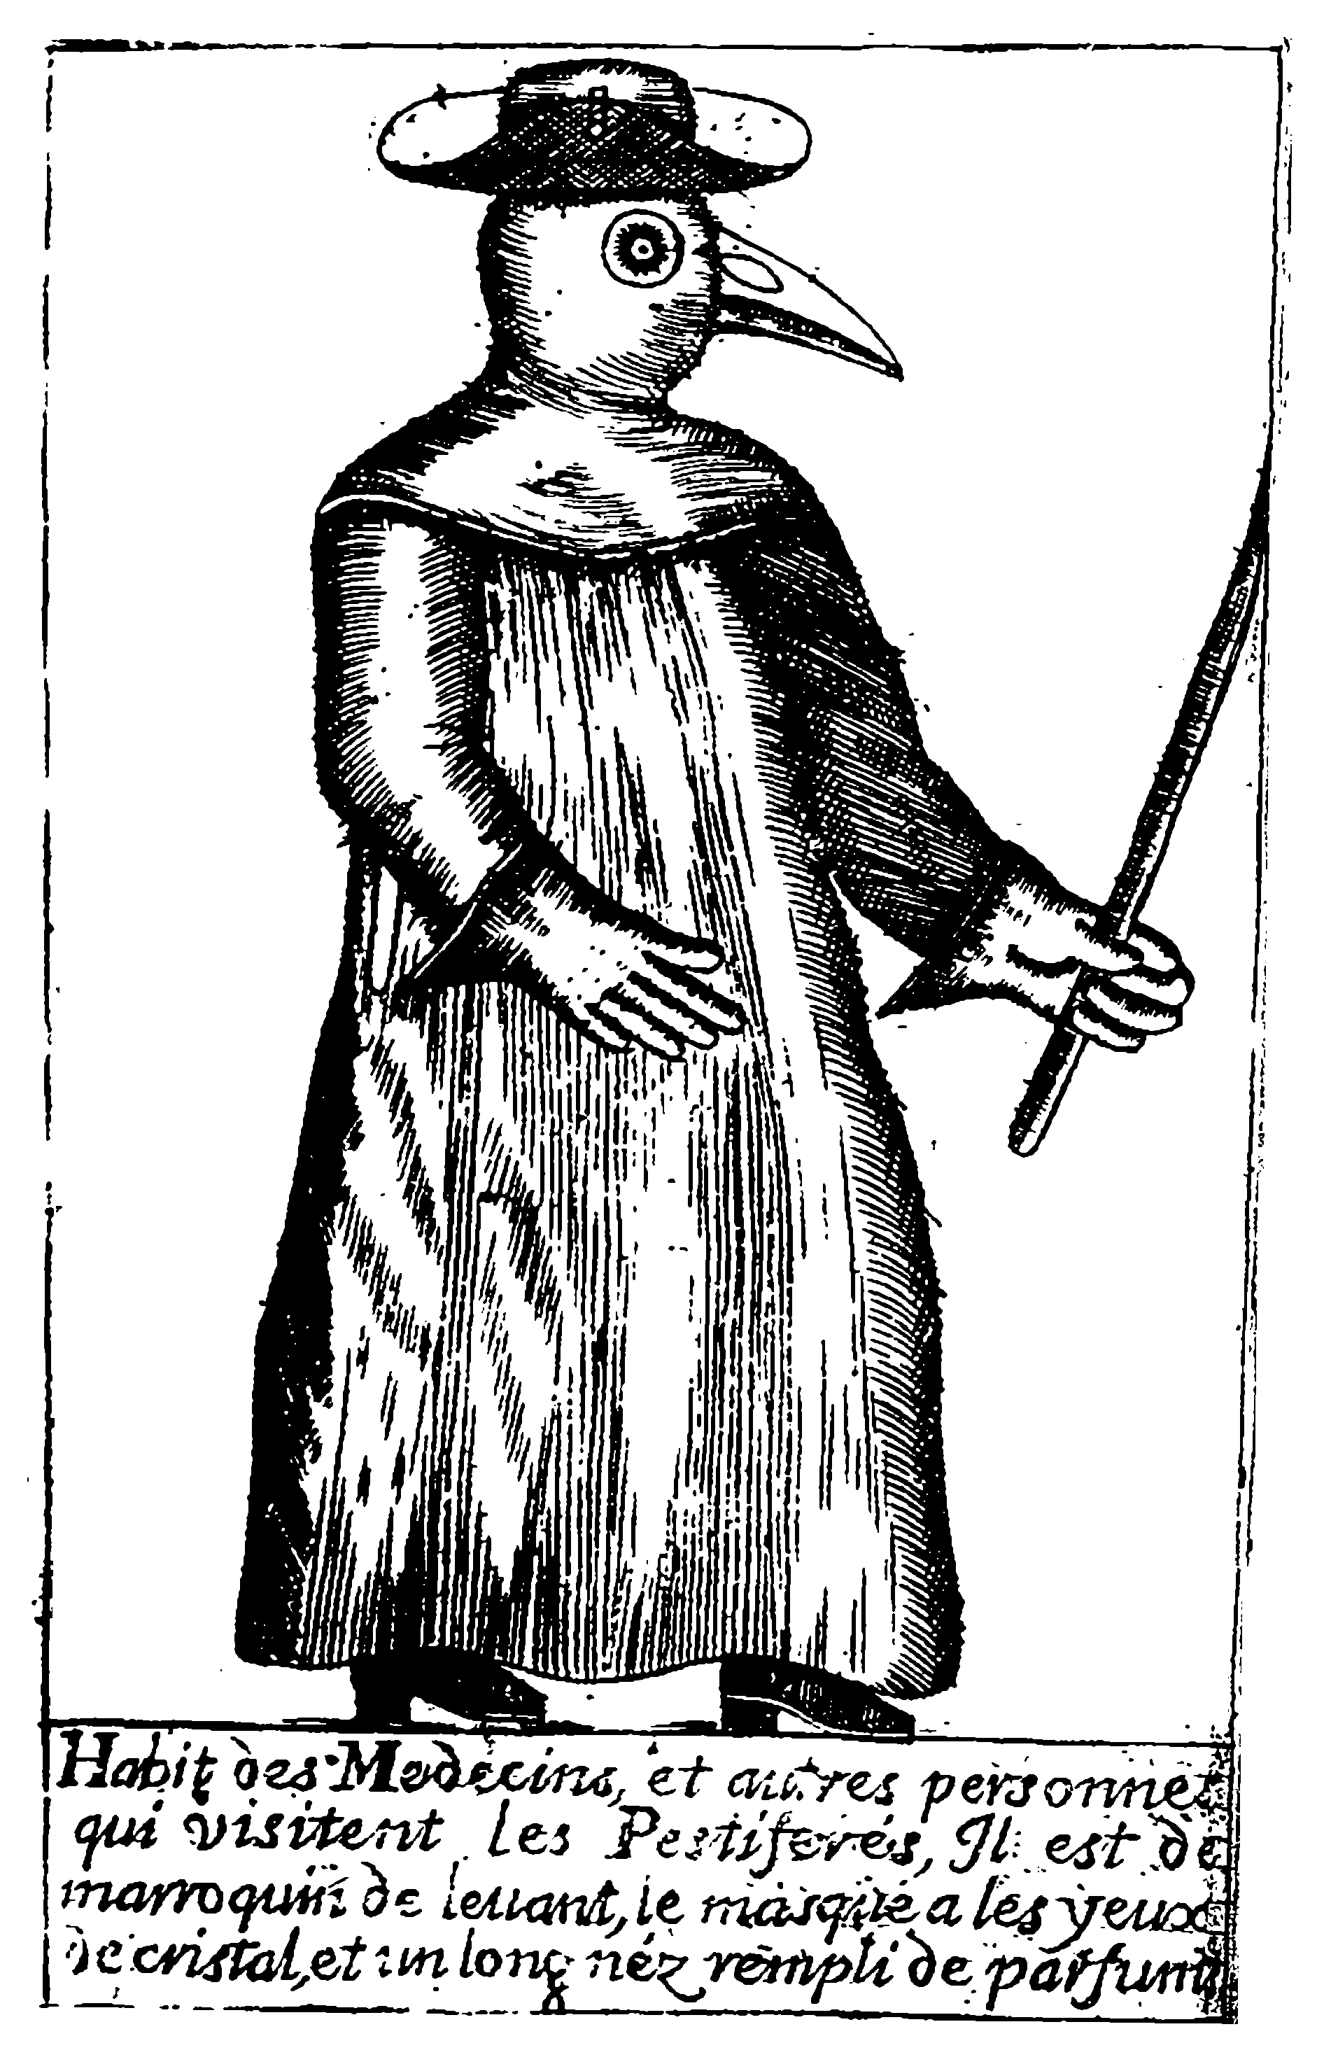
THE MEDIEVAL WORLD
THE BLACK
DEATH
STATION THREE
SYMPTOMS OF THE BLACK DEATH
Label a human body with the symptoms commonly associated with the black death. Highlight which parts of the body were affected and use annotations to provide an explanation of the symptoms. The information card will provide you with an overview of common symptoms to help you complete this task.
AVAILABLE MATERIALS:
Information card
Human body outlines
THE MEDIEVAL WORLD
STATION FOUR
THE BLACK
DEATH
TREATING THE BLACK DEATH
A varied range of methods were employed to try and treat the black death. Using the information provided, write a treatment plan to assist a plague sufferer overcome their symptoms.
AVAILABLE MATERIALS:
Information card
Treatment plan template

Slide 3
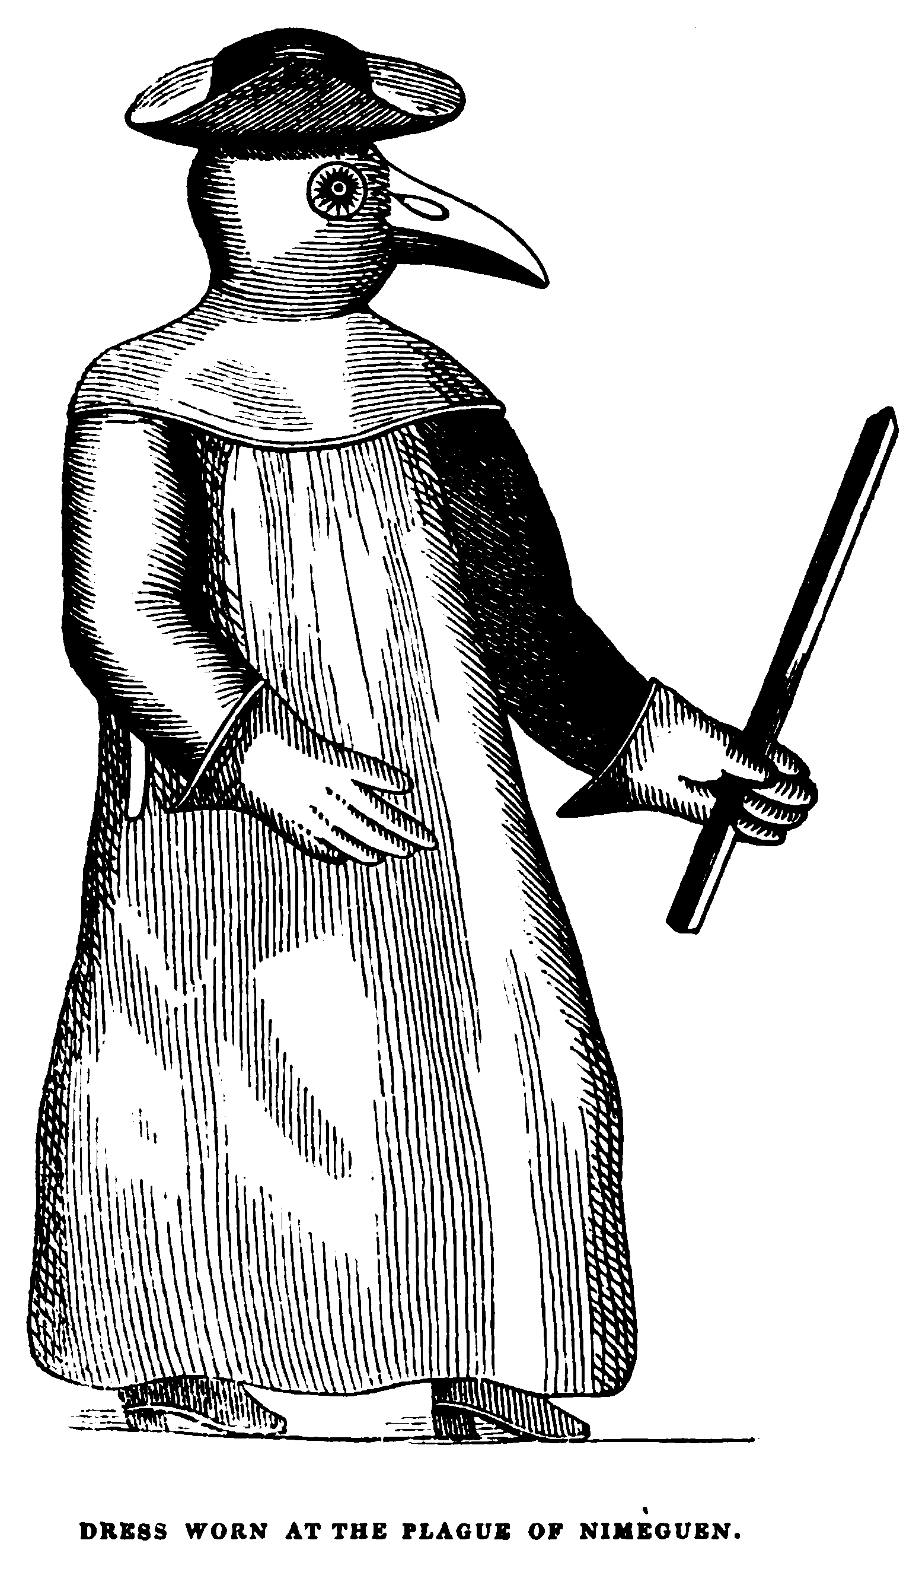
THE MEDIEVAL WORLD
THE BLACK
DEATH
STATION ONE
PLAGUE DOCTORS
Plague doctors were on the front line when it came to treating victims of the black death. They travelled between outbreaks and attempted to reduce the number of infected and treat those for whom it was too late.
Whilst plague doctors were hired by towns and cities specifically for their expertise as physicians, they often did not have a great deal of training in their field. More often than not plague doctors simply quarantined plague victims and disposed of their possessions.
Plague doctors were characterised by their unique clothing. A mask was worn that resembled that of a birds beak. The ‘beak’ was filled with a combination of items that had a fragrant or strong odour, e.g. herbs, flowers, vinegar and garlic. At the time it was commonly believed that the plague could be spread through inhaling bad smells-the combination in the mask aimed to eliminate the chance of a doctor becoming infected. In addition to the mask, plague doctors would wear a floor length coat which extended up and over their heads.

Slide 4

THE MEDIEVAL WORLD
THE BLACK
DEATH
STATION TWO
THE SPREAD OF THE BLACK DEATH
The Black Death infection was carried by fleas, which lived on and subsequently infected rats. When the rats died, the infected fleas would leave the rat and move on to a new host, thus increasing the potential for infection. Rats were commonplace in homes, ships and within many aspects of medieval life, meaning that those that came into contact with rats were infected soon after.
Historians generally agree that China was where the first outbreak of the Black Death occurred. Following this outbreak it has been suggested that the plague moved towards Europe and the Mediterranean via traders using the Silk Road (a series of roads and trading routes between Asia and Europe). Conflicts on the border of Europe and Asia led to the rapid spread of the plague, with invading armies bringing the plague to cities. It was at this point the rate of infection spread rapidly through cities and to others parts of the continent through movement of people on road and ship. Beyond Europe, the plague also spread to northern Africa and the Middle East.
Whilst the plague has swept through Europe and Asia multiple times throughout history, the worst incidence of the plague occurred between 1330-1351 resulting is the loss of around 100 million people.

Slide 5
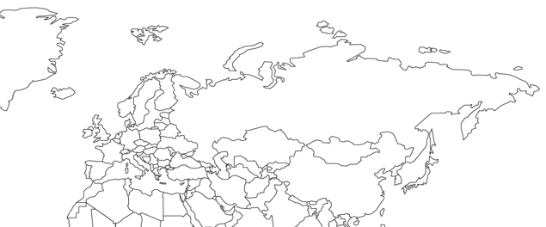
THE BLACK
DEATH
THE MEDIEVAL WORLD
STATION TWO

Slide 6

THE MEDIEVAL WORLD
THE BLACK
DEATH
STATION THREE
SYMPTOMS OF THE BLACK DEATH
BUBOES
The term buboes refers to large swollen lumps that would appear on the body of an infected person. These lumps tended to cluster around the neck, groin and armpits before spreading further across the body. Buboes would progress in colour from red to purple to black and be intensely painful, eventually oozing pus. The black colour of the buboes is linked to the origin of the term ‘the black death’.
OTHER SYMPTOMS
In addition to the buboes plague victims would also suffer from headaches, fever, chills, vomiting, delirium, diarrhoea pain and loss of speech and motor control.
SURVIVAL RATES
Survival rates of the black death were low, with an estimated rate of survival of only 25-50%. Those who did not survive generally died within three-seven days of noticing symptoms. In many cases whole villages and communities were wiped out from the plague, with buildings, farms and livestock being left abandoned as a result.

Slide 7
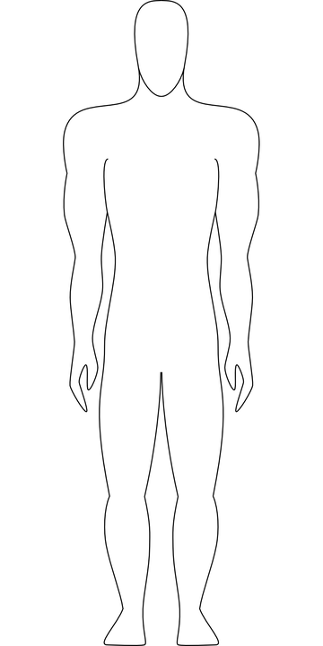
THE MEDIEVAL WORLD
THE BLACK
DEATH
STATION THREE

Slide 8
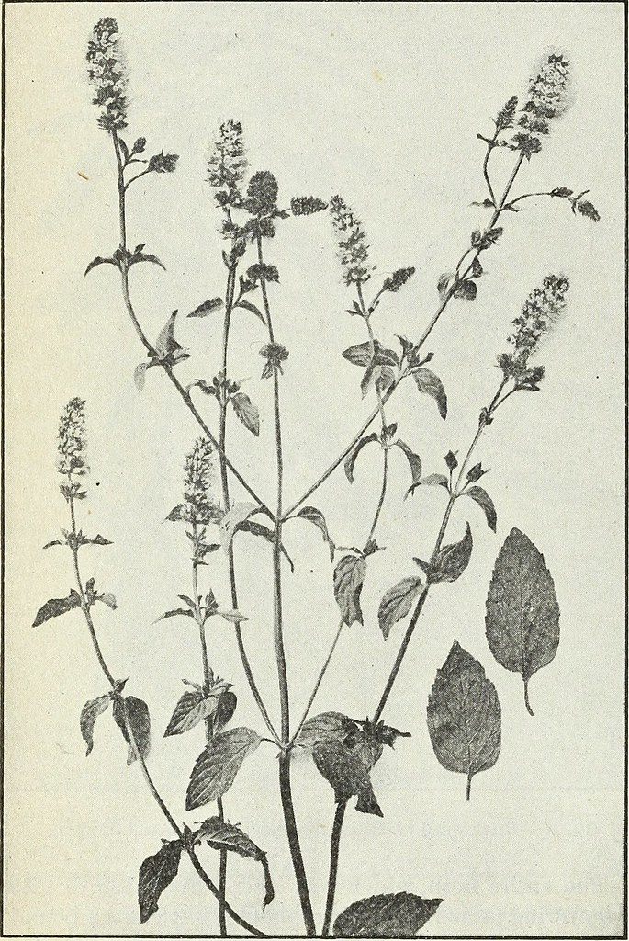
THE MEDIEVAL WORLD
THE BLACK
DEATH
STATION FOUR
TREATING THE BLACK DEATH
At the time of the Black Death there was an extremely limited understanding of medical science and contagion. Whilst there were doctors with medical training, the majority of communities were treated by monks or local healers, generally using herbal and traditional remedies. Whilst some of these remedies could be effective many weren’t, and some medical practices often increased the likelihood of infection or death.
Treating the black death often involved using herbal medicine or burning herbs in order to ward of bad smells, bad smells at the time being a commonly accepted cause of the plague. Other methods included blood letting. The aim of blood letting was to remove dirty or infected blood from the body. During the plague this involved cutting buboes to release the blood from the body or alternatively using leeches to suck the blood out.
Various combinations of herbs, ointments, onions, animal parts and even faeces were rubbed on to buboes in an attempt to cure people of the disease.
In addition to this limited infection control was used and plague victims were often left completely isolated in their homes.

Slide 9
THE MEDIEVAL WORLD
THE BLACK
DEATH
STATION FOUR
BLACK DEATH TREATMENT PLAN TEMPLATE
IDENTIFICATION OF KEY SYMPTOMS | SUGGESTED TREATMENT
MEDICINES/TREATMENT ITEMS REQUIRED | FOLLOW-UP PATIENT CARE

